Slide 1
Agenda of Meeting & Minutes of Meeting
By
Snehal Patanwadia
Assistant Professor
CDC PIT

Slide 2

Agenda of Meeting
An effective agenda sets clear expectations for what needs to occur before and during a meeting.

Slide 3
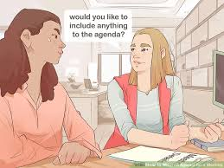
Some Tips For Designing An Effective Agenda For Meeting
Seek input from team members.
Select topics that affect the entire team.
List agenda topics as questions the team needs to answer.
Note whether the purpose of the topic is to share information, seek input for a decision, or make a decision.
Estimate a realistic amount of time for each topic.

Slide 4

Some Tips For Designing An Effective Agenda For Your Next Meeting
Propose a process for addressing each agenda item.
Specify how members should prepare for the meeting.
Identify who is responsible for leading each topic.
first topic “review and modify agenda as needed.”
End the meeting with a plus/delta.

Slide 5
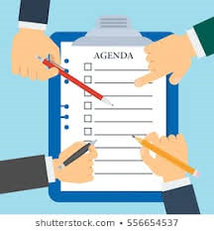
SOME TIPS FOR SETTING AGENDA OF MEETING
Create your agenda early. ...
Clearly define your meeting objective. ...
Prioritize agenda items. ...
Break down agenda topics into key points. ...

Slide 6

MINUTES OF MEETING

Slide 7
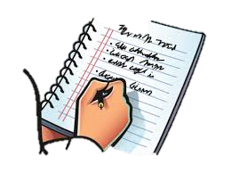
“What are, and how to take meeting minutes?”
Meeting minutes can be defined as written or recorded documentation that is used to inform people of what happened during the meeting and define the next step planned.

Slide 8
To write effective meeting minutes you should include:
The names of the participants
Agenda items
Calendar or due dates
Actions or tasks
The main points

Slide 9
To write effective meeting minutes you should include:
Decisions made by the participants
Record what is the most important points
Future decisions
Documents: images, attached files

Slide 10
Efficiency & pro tips:
During the meeting: You need to build your notes as the meeting progresses
After the meeting: type out your notes in a logical manner and not chronologically.
Meeting Minutes as a Historical Document: As a historical document, minutes are useful for documenting the key ideas or discussion points that led to a decision.
When and How to Share Meeting Minutes: Ideally, meeting minutes are recorded on an electronic device, such as a laptop or iPad, and following a quick review of spelling, grammar, and clarity, disseminated to meeting participants electronically at the end of the meeting.

Slide 11
8 critical tips to run effective team meetings
1. Prepare a meeting agenda in
advance
2. Meeting are work sessions, not
reporting
3. Identify a meeting owner
4. Always be on time

Slide 12
8 critical tips to run effective team meetings
5. Cut down on attendees
6. Create accountability
7. Set up the right environment
8. Get feedback to improve

Slide 13


